Slide 1
Applying a SOLID Framework for Cleaner Code
Presented by Steve Ball
Notes:
This presentation was created for the 2019 European CLA Summit in Krakow, PL.
Applying a SOLID Framework for Cleaner Code
The Composed Systems MVA framework is a SOLID and open source extension of the LabVIEW Actor Framework. Users of this framework will never have to write another actor core event handling structure again! Learn to easily create and manage nested model and user interface hierarchies using dependency injection to aid In project organization. In addition to a high-level overview of features and capabilities, the presenter will showcase a sample project to discuss workflows and best practices.

Slide 2
About the Presenter
Steve Ball is a Certified LabVIEW Architect from Massachusetts, USA
He has twelve years of experience developing LabVIEW software professionally
He joined Composed Systems in 2018
His academic background is in Physics and Chemical Engineering
Notes:
I have twelve years of experience developing robust LabVIEW solutions for my clients and colleagues. I first used LabVIEW 5.1 in 2001. Started my LabVIEW software development career in 2007.
Like many CLAs, I went to school to study physics and engineering and not computer science.

Slide 3
About Composed Systems
www.composed.io
Composed Systems is a LabVIEW Software Consulting company located in the Greater Boston Area, USA
All of our partners hold the Certified LabVIEW Architect certification
We provide LabVIEW consulting services and bring our technical leadership skills to clients across a wide range of industries
We are a National Instruments Alliance Partner and active in the greater LabVIEW community
Notes:
Composed Systems is a LabVIEW Software Consulting company located in the Greater Boston Area.
All of our partners are hold the Certified LabVIEW Architect certification from National Instruments.
We provide LabVIEW consulting services and bring our technical leadership skills to clients across a wide range of industries and project types.
We are a National Instruments Alliance Partner and active in the greater LabVIEW community, through presentations such as this one and by our contributions to the open source LabVIEW community

Slide 4
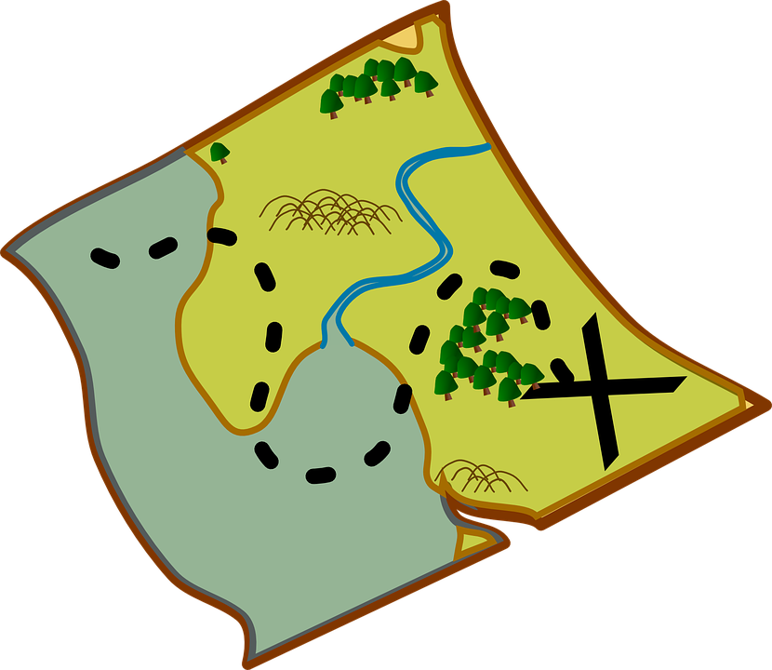
Roadmap
What is the MVA Framework?
Features and benefits
How to use it?
Sample Project
Too much to cover in the given time!
Please hold questions for the Q&A period

Slide 5
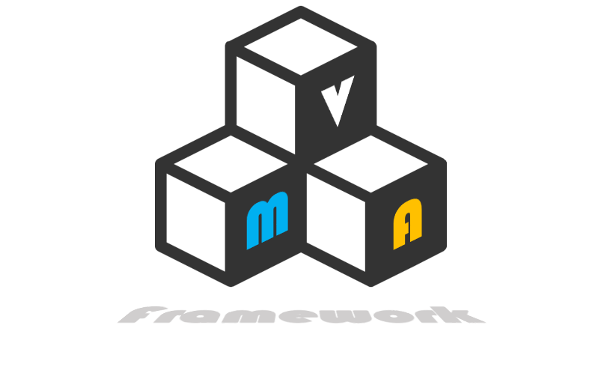
The MVA Framework
Open Source, MIT Licensed
Composed Systems daily use framework
Now a G package on gpackage.io
Check out our other packages too!
Notes:
MVA Framework – Mediated Viewable Actors
Created by Ethan Stern and presented at NI Week and the Americas CLA summit 2018
This is how we use it at CS, in an open source sample project
This is not the only way to use it
For smaller examples see Ethan’s demo
My demo is larger and uses many of our open source tools along with the framework

Slide 6
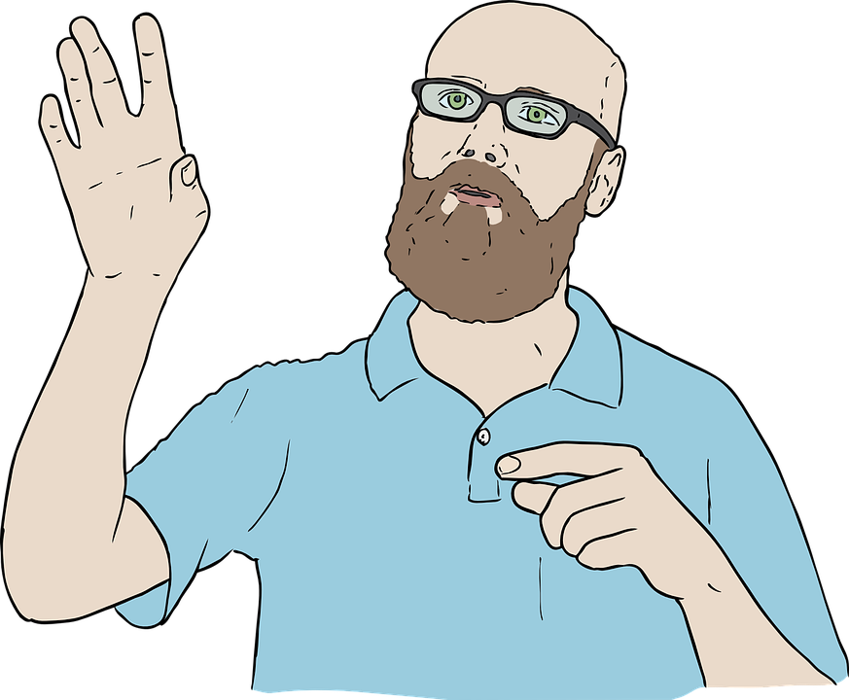
MVA is made of Actors
Actor A
Actor B
Actors are:
Independent
Asynchronous
Queued State Machines
Actors can Send and Receive
Messages
Actors can use inheritance
and composition
Notes:
This talk requires building on basic actor framework concepts
Actors
Everything is an actor
Asynchronous QSM
Send messages to each other
Are LV objects that can use inheritance and composition

Slide 7
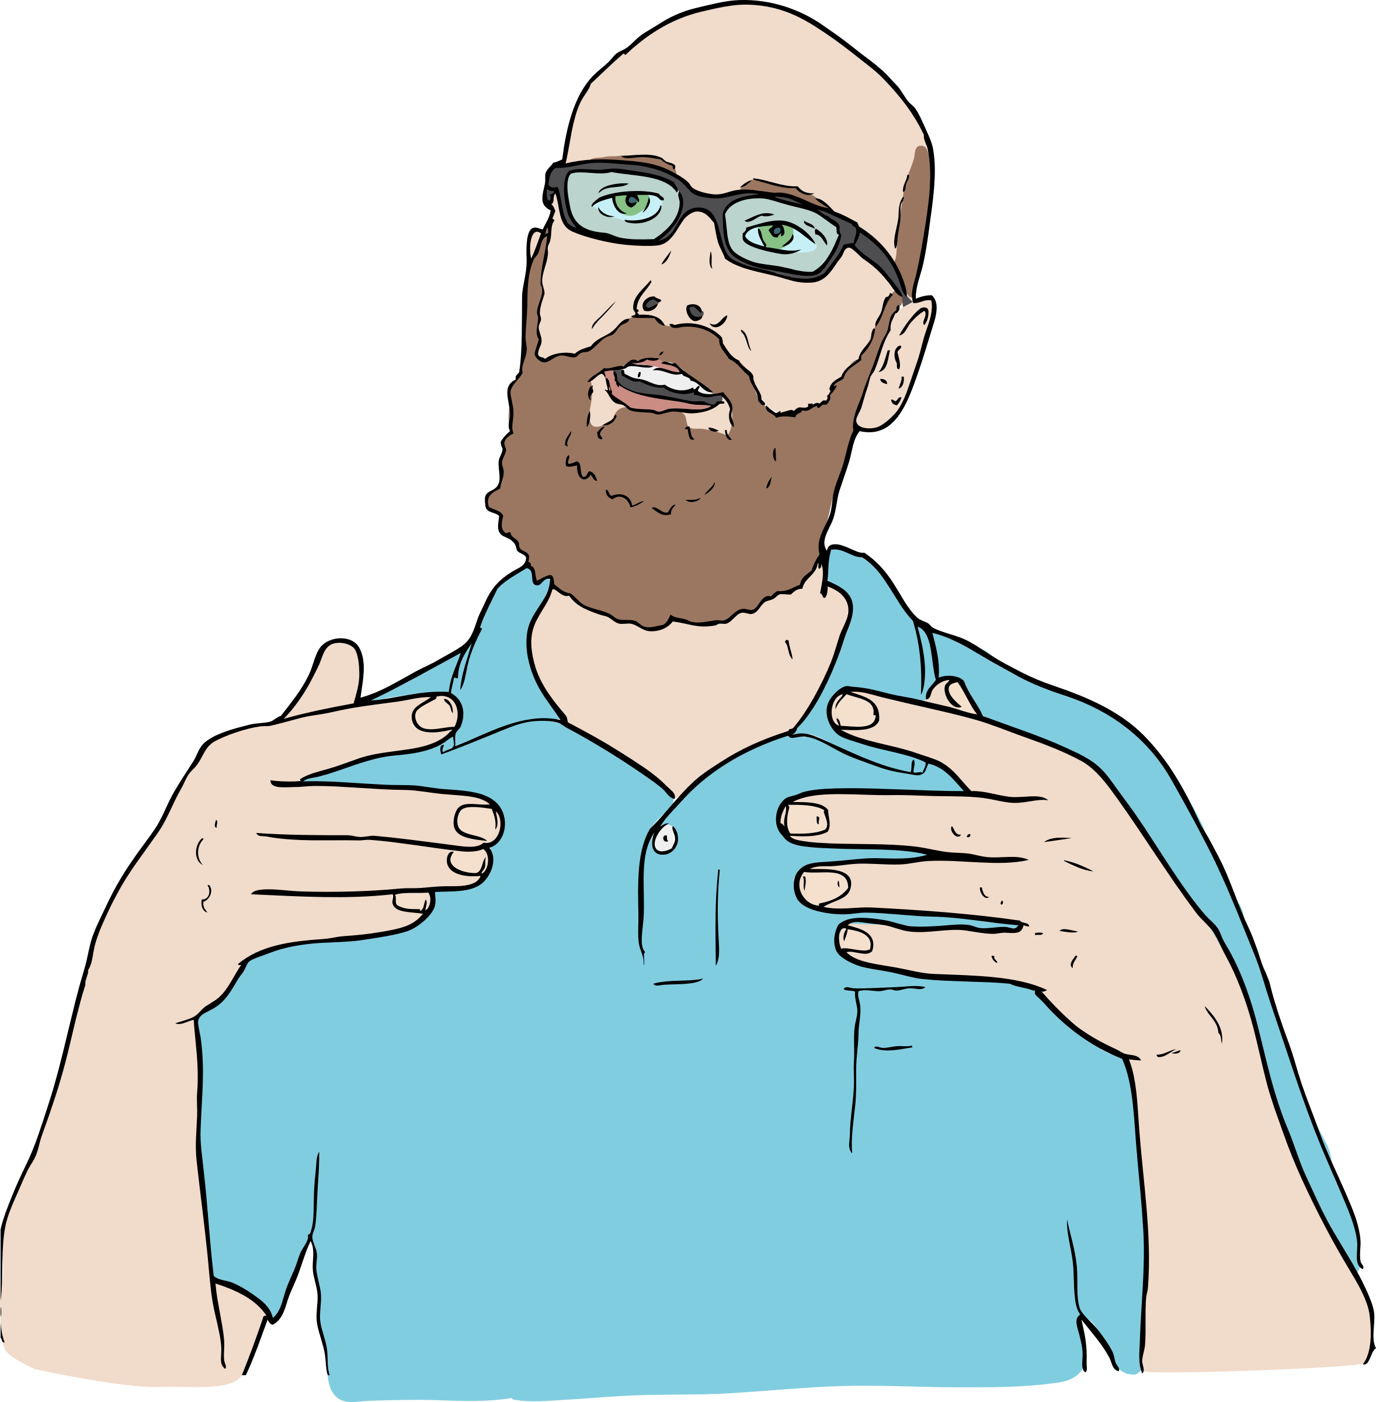
Actors Use Messages
A Message
Messages are:
A Class
Transported from Sender to Receiver
Events and data as one
How to route messages?
MVA uses a Mediator
Actor A
Actor B

Slide 8
Mediator Pattern
Mediator
Mediator
Registers to send
Requests message
Publish
Receives
Actor A
Actor B
Actor A
Actor B
Notes:
An actor can send a datatype using a name and a type. Anyone can subscribe (before or after the publisher) to listen to that data, as long as the subscriber knows the name and the type.
There could be multiple subscribers, with different subscription policies. But for this case, we have Actor B as the sole subscriber with a basic subscription policy.
The basic policy sends the message any time the value changes.
So when Actor A publishes that data, and Actor B will receive A.
Actor B can then execute the appropriate method corresponding to the message type.
So far, we’ve been using vanilla actors. In the MVA framework, there are a few specialized actors that make up most of our application.

Slide 9
Models, Views, ViewModels, oh my!
The ViewModel is the Root Actor that owns Models and Views
Compositional hierarchy, not inheritance
Views deal with formatting data for display and capturing user events
Models deal with everything else
Views and Models are decoupled
ViewModel
Root Model
Root View
Notes:
Views, Models and ViewModels.
MVVM – MVC – MVW is a common pattern that will always be relevant as long as we care about separation of concerns and reducing coupling between our code modules.
By explicitly defining these abstractions in the framework we can provide a robust set of functionality to make development easier and define a consistent application structure that aids in team development.
The ViewModel is the Root Actor that owns Models and Views
Views deal with formatting data for display and capturing user events
Models deal with everything else

Slide 10
Models
Models do the work
Models use injectable interfaces to define methods
Models are arranged in a compositional hierarchy
Models receive messages and execute the appropriate methods
Models may publish data to the mediator bus
Model
Notes:
The MVA framework does not impose a design constraint for models. The implementation could be simple state machines.
I’m presenting my preference and the approach we generally take at Composed Systems.
Models work as independent asynchronous actors.
They register for messages to listen to on the mediator bus and map them to their methods.
The model hierarchy uses composition. Our models are created with an interface that defines methods and their connector panes.
This allows for dependency injection, which makes the models more testable (via mocking) and extensible.
Models
Models are actors
Methods exist and execute when messages arrive
Models generate and process data for use by models

Slide 11
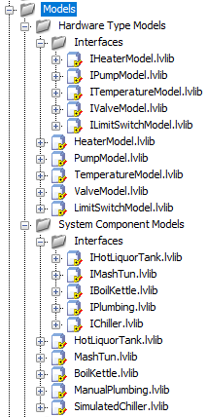
Models and the Mediator
1. Requests / Registers for Notification Messages
2. Maps Notification messages to methods
3. Publishes Model Data to mediator bus
Notes:
Let’s discuss the different ways that models can interact with the mediator:
Map the model’s methods to mediator values using ‘request message’
Put results onto the mediator bus for consumption by views or models using ‘Publish model data’

Slide 12
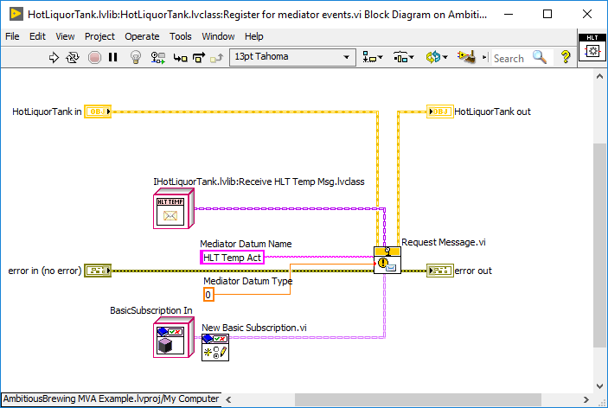
Model - Requesting a Message
Notes:
Models can use ‘request message.vi’ to link an incoming message to one of their methods.
When the message is received, it will then run that method.
The exact name string and exact type must match!
To use this technique, the message needs to be a ‘notification message’ type.
Examples of subscription types:
Basic - any updates
Value change – value change only

Slide 13
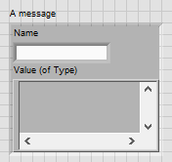
Notification Messages
Notification Messages are Classes
That have a:
Name as String
Value as Variant
Type as agreed upon between publisher and subscriber
Notes:
When models send or receive messages, typically they are sending Notification messages.
These are a special kind of actor message that have a name and a value.
Messages
Should be ‘events’ used to trigger updates in subscribers
Should not be blasting data onto the mediator bus ‘just because’
Polling the bus is a smell
Spamming the bus with thousands of updates is a smell – bus throughput should not become a bottleneck in a well designed application
For higher throughput, design a mechanism for direct communication between the involved entities. Use your CLA! (Plenty of options)
Abstract messaging.
Reuse types of messages
API becomes familiar

Slide 14
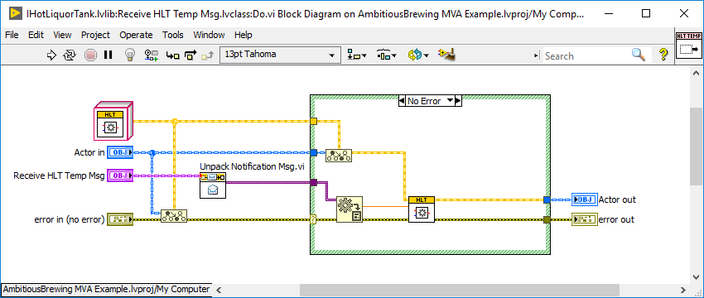
Notification Message
Notes:
To use this technique, the message needs to be a ‘notification message’ type
The notification message ‘do’ method needs to unpack the notification message to pass the value to the VI it is calling.
Note this differs from traditional AF messaging – you will have to modify these messages manually to set them up.
Notification messages are different from normal actor messages in a few important ways.
The transport is not in the concrete message's private data, instead is stored as a variant in the parent class.
To access the data and pass it to the correct function, use 'unpack notification message' and 'variant to data' with the correct type, instead of unbundling.
There is implicit type safety – the VTD doesn’t need the type wired in. The mediator can only supply the correct type. The message defines the type.

Slide 15
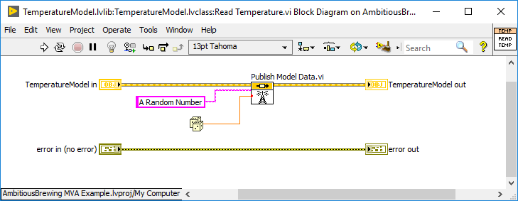
Model – Publish Model Data
This talk assumes some familiarity with common LabVIEW Actor Framework abstractions.
I will highlight the important bits briefly
Notes:
As event-driven asynchronous actors, Models are expected to ‘publish model data’ to the mediator bus as they do meaningful work
This data can then be consumed by subscribers (other models or views) as required.
The API for sending a value update uses a string name and a variant value.
The framework also provides a mechanism for exclusive publication (lock and unlock).
Models can interact with more than just the mediator bus!
If they are composed of other models and launch them, they can use the enqueuers to send normal actor messages.
They can also use their own enqueuer to send messages to themselves.
Models are not limited to these behaviors or patterns in any way - although this is how we tend to use them.

Slide 16
The ViewModel
Has an actor core with a subpanel that contains the application’s views
Can receive application menu events
Can receive nested events (if not handled by nested views)
The only place in the View hierarchy that can publish data to the mediator bus
ViewModel
Notes:
The ViewModel
Root actor
Binds the Models and Views into a hierarchical structure
Receives application shortcuts
The highest level View events can be acted upon
The only point of interaction between views and models

Slide 17
Views, ViewManagers, and the ViewModel
ViewManagers contain splitters and subpanels that can contain views
All can read data from the mediator bus
Only the ViewModel can publish to the mediator
Views and ViewManagers can send value updates up the hierarchy to the ViewModel
ViewModel
A ViewManager
A View
Notes:
The ViewModel is at the top of the View hierarchy, which is composed of Views and ViewManagers
ViewManagers can have subpanels containing other Views. These use the ‘protected subpanel’ abstraction for ease of use.
Views should be thin and singular in purpose – a row of buttons, a plot, a field of indicators, etc.
When Views become too complex, we break them into more ViewManagers+Views.

Slide 18
Views
Views display data and capture user interaction
Views are arranged in a compositional hierarchy
Views pass value updates up the hierarchy all the way to the ViewModel
ViewManagers are Views that contain other Views
Views and ViewManagers can be used together to make nested user interfaces
Root View
Notes:
Views format and display data from the mediator bus
and capture user interaction by generating value updates
We use indirect composition to create the hierarchy, using a method called ‘write startup views’ to add the view class and name to the owner.
Views can send value updates. These don’t go to the mediator, just to the parent view.
The default behavior is to pass the value updates all the way up to the ViewModel, where it can be interpreted and published to the mediator bus if necessary.

Slide 19
Views and Events
ViewModel
Override these methods to act on it!
B
A. Receive Value Change Event
Root View
B. Catch Nested Value Update
A WILD
VALUE CHANGE EVENT!
B
B
A
Notes:
Views and ViewModels can register for control events
The events are captured by the framework and passed up the view hierarchy all the way to the ViewModel
Any View or ViewModel that would like to receive and act on the event can override specific Vis depending on the event type.
One button click, for example, is send to all views in the hierarchy. Each view can act on the event independently, or ignore it (default behavior).
If a view outside of this path needs to react to the value change event, the ViewModel could publish ViewModel data in catch nested value update that the unrelated view could subscribe to.

Slide 20
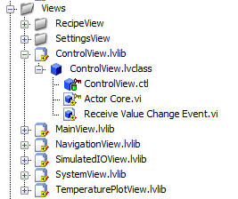
View Mechanics
Bind things to Mediator Values
Request Data for display
Register for Control Events
Send Value Updates
Notes:
Let’s review what I consider the core View functionality
Here’s where the framework does a lot of the heavy lifting for you and gives you a set of robust options.
1. First binding mediator values to things: control or indicator values, captions, or many other aspects of the view is straightforward.
2. If the data on the bus isn’t suitable for direct display, and needs unit conversion or formatting, we can use the ‘request data’ method instead.
3. Register for control events provides a way to program events without event structures that was teased in the abstract.
4. Views send value updates in the specific way we discussed a short time ago. We will look at the implementation.
The ControlView in today’s demo project does it all with two methods!

Slide 21
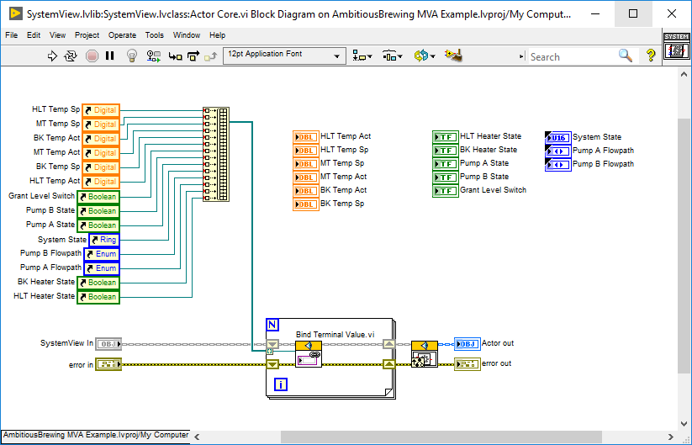
Views – Binding Terminals to Mediator Values
Notes:
Bind terminal values has a simple API,
Just wire the control reference and it will be linked to the mediator bus to a datum with the same name.
If the name is different, just wire it in.

Slide 22
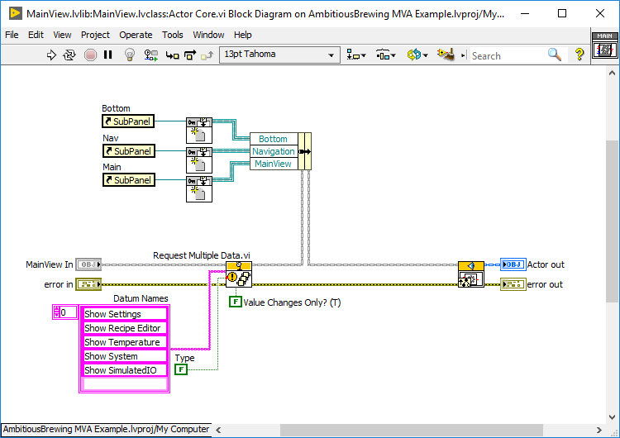
Request Multiple Data
Notes:
If we need to format data, or it doesn’t map to a terminal value, we can use request data or request multiple data.
Here this ViewManager is listening to Boolean type datum on the mediator bus that originates from the ViewManager when it receives menu events.
This ViewManager should then change the subpanel shown accordingly.
Also shown is the subpanel reference with the ‘new protected subpanel’ method. These are used to insert various Views into the subpanel.
- Add labels to constants

Slide 23
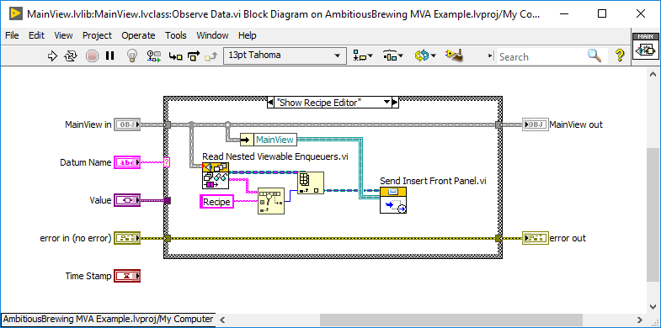
Observe Data
Notes:
Observe data is the partner function to request data.
Here the datum name and type are passed in, and we can act accordingly.
When ‘Show Recipe Editor’ changes value, we read the nested view enqueuers, search for the one called Recipe, and send insert front panel.
I will show later on where the name ‘Recipe’ is assigned to that nested Viewable.
-remove case insensitive match

Slide 24
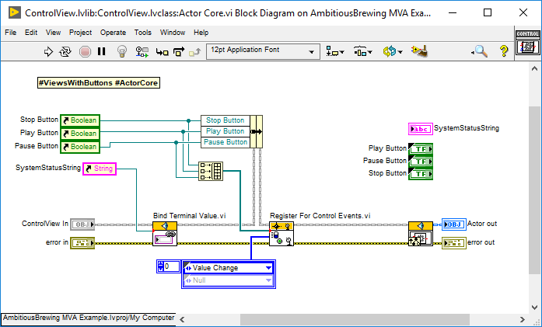
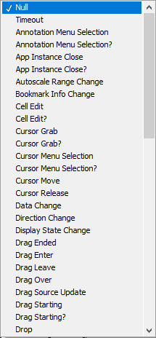
Register for Control Events
Notes:
To capture UI events and act on them, use ‘register for control events’
The enumerated array will register all controls for each type of event present
Useful for registering for multiple event types for multiple controls
Here, I want to managing the state of some buttons and use them to send value updates to the ViewModel, where the ViewModel can publish the commands to the mediator bus.
-- add animation with enum expanded

Slide 25
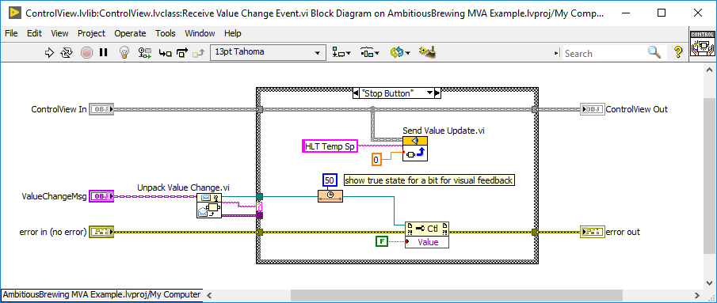
Receive Value Change Event
Notes:
If your View registers for value change events, override ‘receive value change event’.
This pattern applies to many different event types.
The message can be unpacked in this case with ‘unpack value change message’
We want to send the value update onwards
This is a good place to translate the value change
Stall data flow – we want to give some visual feedback before changing the button state back to false.
This is huge for UX!

Slide 26
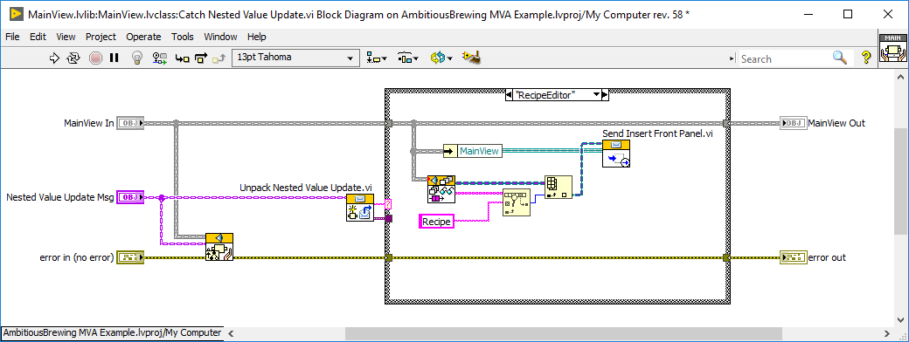
Catch Nested Value Update
Notes:
This is available as an override at any level in the view hierarchy, up to the ViewModel
The event is passed up the hierarchy and any view may react as it needs to.
The ViewModel is THE place for any interaction with the mediator bus and models.
In this example I’m catching a value changed in a nested view – the navigation view that has big buttons that change what is displayed in another subpanel of the main view.
First make sure to call the parent, which will propagate the nested value update to this ViewModels parent. If we don’t, it won’t make it past here and other views will not be able to act on it.
Following a similar pattern, we unpack the nested value update and use a case structure to act on the datum names accordingly.
Here we are searching for a view associated with ‘settings’ and inserting it into the mainview subpanel on the main view.

Slide 27
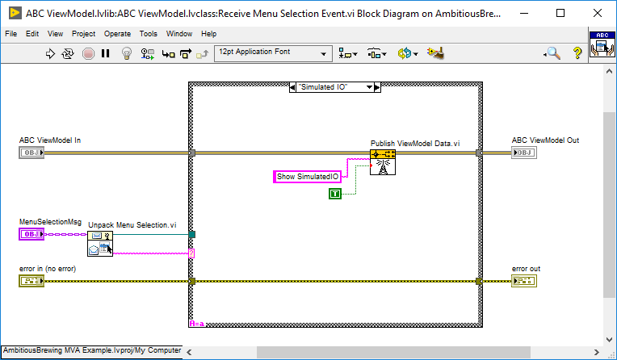
ViewModel: Receive Menu Selection Events
Notes:
The ViewModel can catch nested value updates and receive menu selection events.
The internals of both Vis look like this. Unpack the message, and depending on the datum name, do something.
Here we receive the menu event called ‘Simulated IO’ and use ‘Publish ViewModel Data’ to send it to the mediator

Slide 28
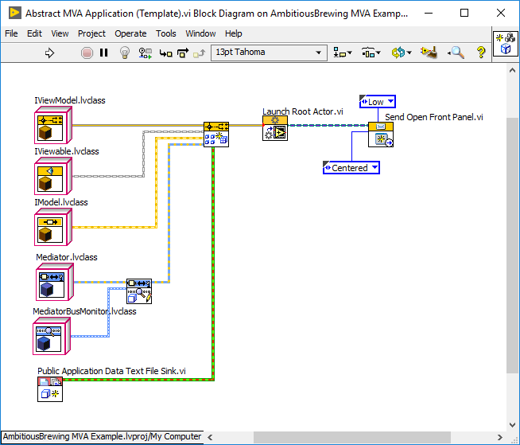
The Assembler Launcher
Notes:
This is the template that ships with the framework.
The top three classes are abstract and to make a functioning program you need to create your own ViewModel and at least one view and one model.

Slide 29
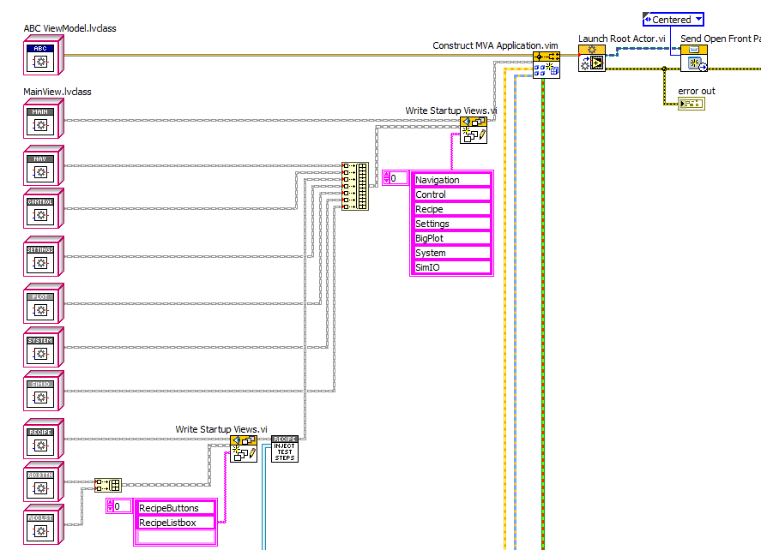
Assembling Concrete Views
Notes:
Here we explicitly assemble the model and view hierarchies
Here I’m using all concrete classes. If I wanted to test the software without hardware, I could case out the concrete classes and use the interfaces instead.
Here I’m using ‘write startup views’ to assign views to ViewManagers, who can then insert the front panels as needed during program execution.
The Assembler Launcher
Top level VI, not an actor
Constructs and launches the ViewModel using launch root actor
Everything in the application explicitly defined, named and ordered
Uses dependency injection to easily change injected types

Slide 30
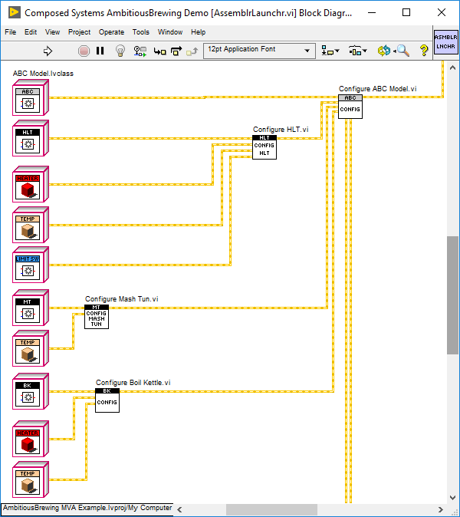
Assembling the Models
Notes:
Assembling the models looks similar, we inject the compositional types using ‘configure’ methods.
They are just private methods for their respective classes that bundle the classes. i.e. classic composition.

Slide 31
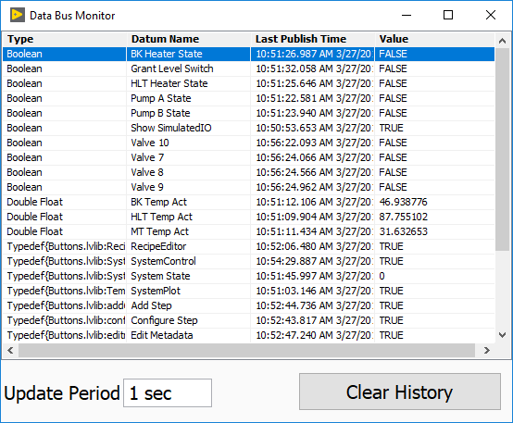
Tools: Mediator Bus Monitor
Notes:
The framework includes an optional bus monitor which can be injected in the assembler launcher.
It’s usually mapped to a key shortcut using the run time menu (which is easy to disable if it’s not desired).
This helps determine what data is on the bus and how often it is being updated.
This uses the Composed Systems ‘Variant Extensions’ gpackage that takes any variant and converts it into a single line string.

Slide 32
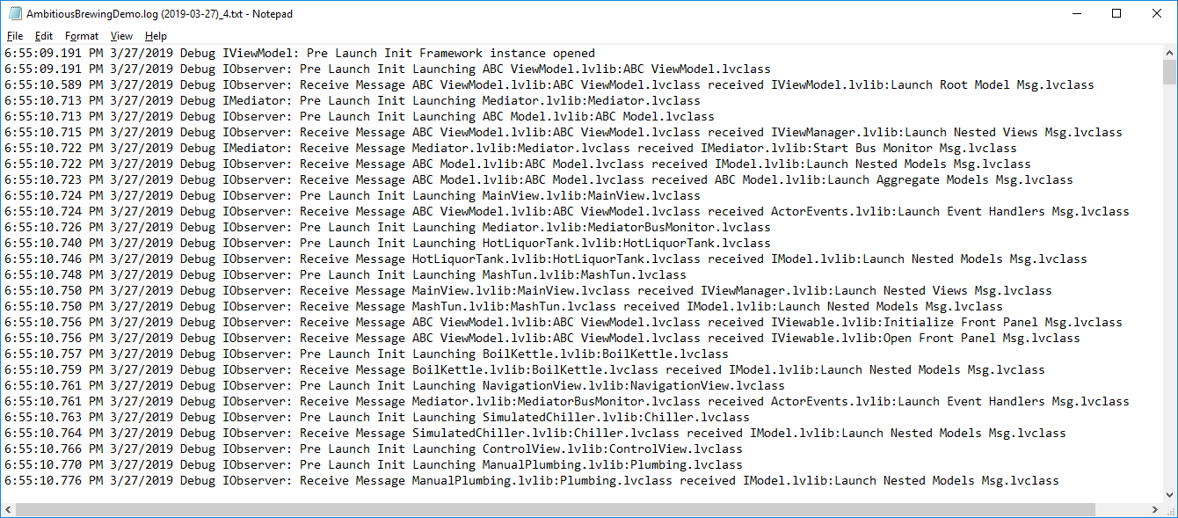
Framework Level Logging
Notes:
One of the newer features is framework level logging. It has a default implementation that logs framework events, such as launching models, new subscriptions, and more. It paints a clear picture of what is happening when in the application. It is also injectable, so if you don’t want this logger or prefer your own implementations, you can override or disable it entirely.
This logger was written by Paul Ross and you should check it out on GPM! I call it ‘the logger to end all loggers’.
https://gpackage.io/packages/@cs/event-logger

Slide 33
Application Control Stack
Process Model
Test Steps
Publishes Model Data to be used by
Invokes
Models
Publishes Model Data to be used by
Hardware
Sends Actor Messages to
>>Performs Action<<
Notes:
User creates or loads a sequence
Sequence begins and calls a test step
The test step sends notification messages to the models
The models send actor messages to their hardware
The concrete hardware then performs the requested action
We have an application-agnostic test executive that can be called by your process model.
It handles saving and loading sequence information, and supports advanced process control such as looping and parallel test steps.
It was written by Jon McBee and it’s really cool. Check it out if you like linked lists and tree controls! See @CS on GPM
The process model is an application specific definition of how to call and handle test step execution.
My process model is a model and calls a generic test step called ITestStep. It calls the ‘get next test step’ from the sequencer and runs it.
From application to application, the details of how this works will always change.
Test steps are models
They should be granular and limited in scope to take advantage of the sequencer’s capabilities.
They can send command messages and monitor the results to determine when the step is finished.
They can have their own parameters that can be set via a configuration view.

Slide 34
Open Source
This presentation and demo is on our website:
www.composed.io
Check out our other projects on Bitbucket:
https://bitbucket.org/composedsystems/
See our 11 (and counting) open source G packages at:
https://gpackage.io
Notes:
I’d like to start with the fact that Composed Systems is dedicated to producing great open source LabVIEW tools.
This presentation, demo project and all of our tools are 100% free and open source and available on our website, bitbucket and on G package manager.

Slide 35
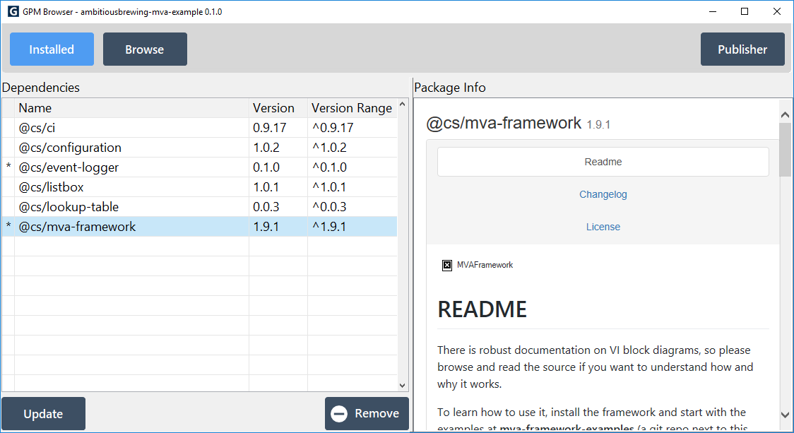
GPM
Notes:
GPM is an open source package manager by MGI that is awesome.
We are using it for our tools and I’m using it for todays demo project.
I encourage you to check it out!

Slide 36
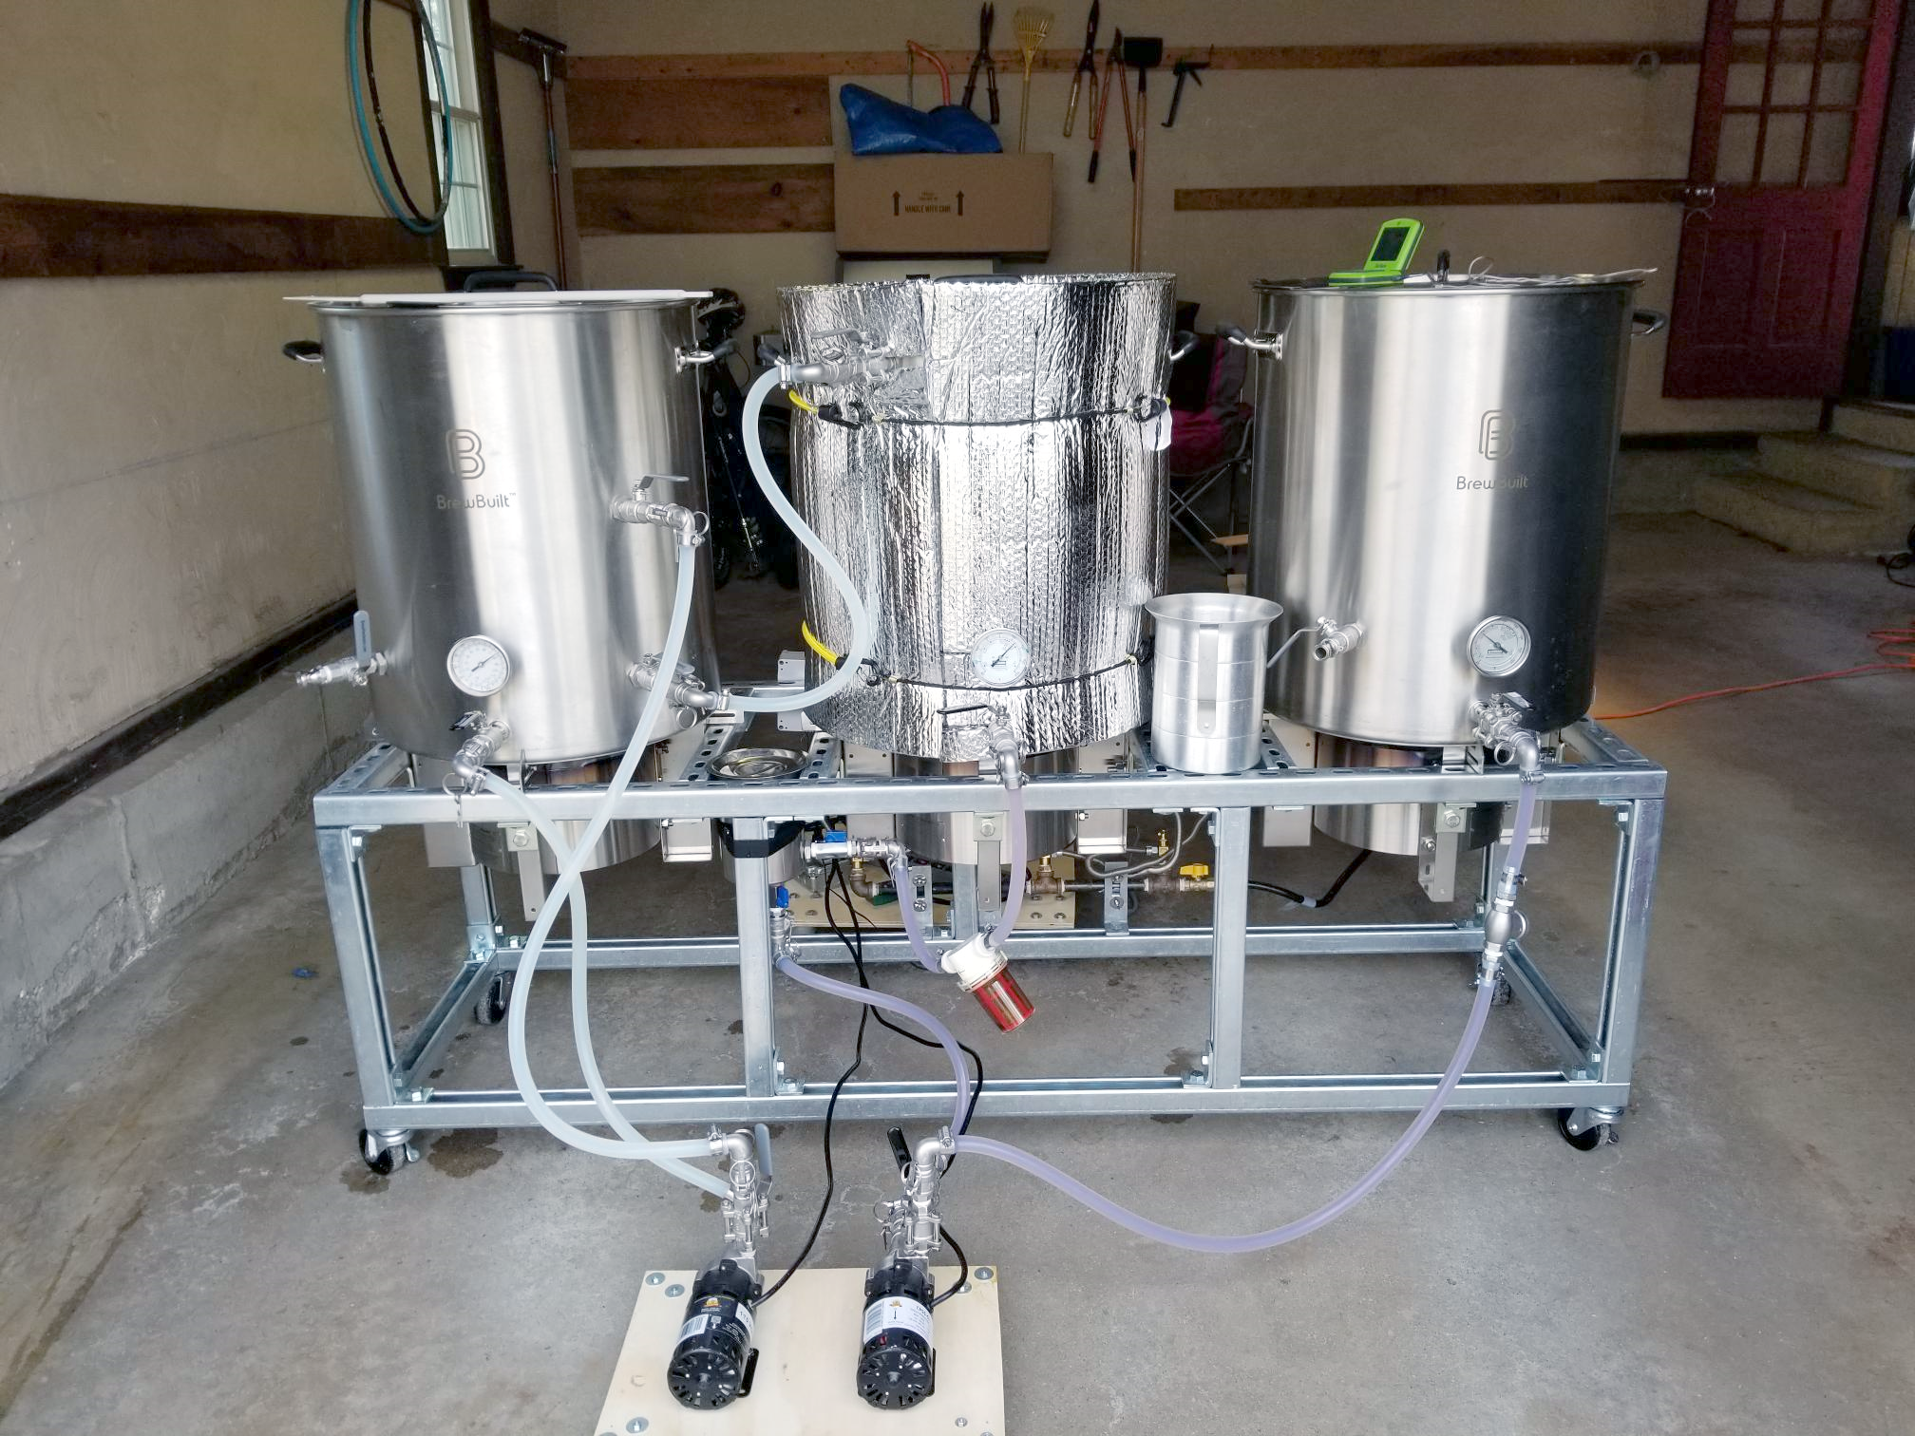
DEMO
Notes:
For today’s demo project I wanted to pick something with enough complexity to be interesting.
Ethan Stern has published a great step-by-step implementation examples of MVA, so I had to go bigger.
The goal is to capture more of the real-world design that we at Composed Systems are implementing using the framework.
If you are following along with the demo project, open the bookmark tool and follow along with the slides.
This is a picture of my friend Wayne’s homebrewing system, which will become the pilot system in the brewery he is opening next year.
Right now it has pumps and manual valves and is not automated. My demo project is to create control software that can interface with temperature sensors, pumps, valves, and level switches, to turn this or any other brewing system into a more instrumented and automated version, for more controllable, repeatable brews.

Slide 37
Thank You
Steve.Ball@ComposedSystems.com
www.composedsystems.com
Notes:
Thank you for downloading this presentation!
We love to talk about LabVIEW and the tools we are building to share with the community.
Please reach out and let us know what you think!

Slide 38
Bonus: How to Implement an MVA Project?
1. Start from the included template, examples, or an existing MVA project
2. Create your new ViewModel and override actor core.
3. Create a new VI to become your assembler launcher and drop that ViewModel
4. Create a single VI for UI layout and then break it up into appropriate views and view managers
5. Use placeholder images or controls and stub out the UI
6. Implement view navigation, application menu and
7. Stub out libraries and models for top-level model
8. Create models for the physical system you are interacting with
9. Create a manual control interface
10. Create granular test steps from manual interface (Open Valve, Enable Pump)
11. Define test step and model interaction
12. Link model data to views as models are implemented
13. Implement features as needed
Notes:
Start from examples or reference an existing MVA application. Use the template!
Create your ViewModel and override actor core.
Create a new VI to become your assembler launcher.
Create a single VI for UI layout and then break it up into appropriate views and view managers
Use placeholder images or controls and stub out the UI
Implement view navigation, application menu and
Stub out libraries and models for top-level model
Model the physical system you are solving
Create a manual interface
Create granular test steps from manual interface
Define test step and model interaction
Link model data to views as models are implemented
Implement Views as needed

